Slide 1
Webinar
Mobility Management
Segmentation in campaigning
28th of April 2015

Slide 2
Introduction

Slide 3
Introduction
How does GoToWebinar work?

Slide 4
Introduction
Programme
timing | subject | speaker
11h00 | Welcome and introduction | Sarah Martens
11h05 | Segmentation and social marketing | Sarah Martens
11h20 | The SEGMENT project | Mark Degenkamp
11h30 | The SEGMENT campaign in Utrecht | Mark Degenkamp
12h00 | Q&A

Slide 5
The CIVITAS Community
Projects:
Dyn@mo and 2Move2
WIKI and CAPITAL
CIVITAS Forum Network
CIVINET local-language networks
10 Thematic Groups

Slide 6
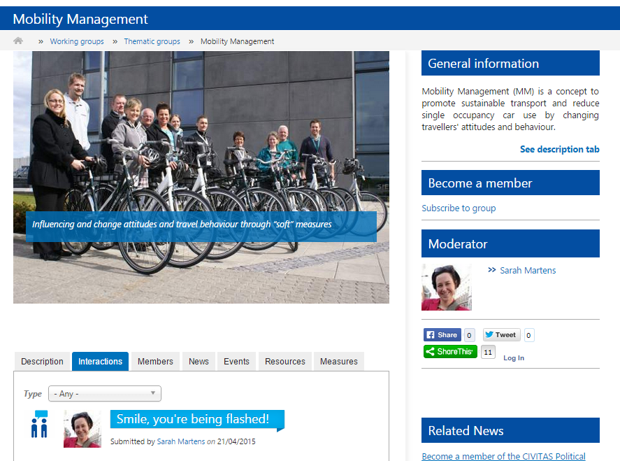
Introduction
This webinar is organised by the CIVITAS Thematic Group on Mobility Management

Slide 7
Information on TG Mobility Management
Join us!
www.civitas.eu/TG/mobility-management
Create profile and request membership
Start discussing
Other examples of segmented campaigns?
What barriers do you encounter?
What kind of support do you need?
…
Send suggestions and questions to sarah.martens@mobiel21.be

Slide 8
The CIVITAS Thematic Group on Mobility Management
Purpose:
Discuss and cooperate on joint products / publications / briefs
How?
Interactive Discussion Platform on civitas.eu
Physical & online meetings
Limited budget to cover travel and specific activities
Collaborative exercises

Slide 9
The CIVITAS Thematic Group on Mobility Management
Questions ?
Ask questions by:
Raising your hand via the GoToWebinar Control Panel
Starting a chat in your control panel

Slide 10
Segmentation and Social Marketing

Slide 11
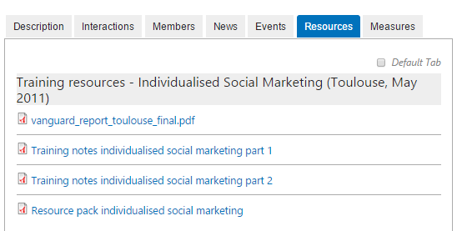
Useful resources
Training materials CIVITAS training Toulouse 2011
SEGMENT project

Slide 12
Social marketing
= The application of marketing techniques to influence voluntary behaviour
Based on an understanding of the audience and of the competition
Modal shift as an exchange: costs vs. benefits
The marketing mix (4 P’s):
Getting the product right
At the right time and place
With the right price
And presented in the right way (promotion)

Slide 13
Social marketing
If applied correctly, social marketing campaigns are more effective than traditional mass campaigns (one size fits all)
Social marketing techniques are also useful in low-budget initiatives
Segmentation = key component of social marketing

Slide 14
Segmentation techniques
= dividing the market into groups of customers
to create different products, services and/or communications to meet their specific needs
Focus your resources on those that have the greatest potential for change
Two approaches:
A priori: based on known characteristics (age, car ownership, …)
Post-hoc: survey of attitudes, behaviour, personality → statistical analysis to define segments

Slide 15
Simple segmentation
Ability vs. willingness
MaxSem:
Able and willing to change | Able and unwilling
Unable and willing to change | Unable and unwilling
New habit
Goal intention
Behaviour intention
Implementation intention

Slide 16
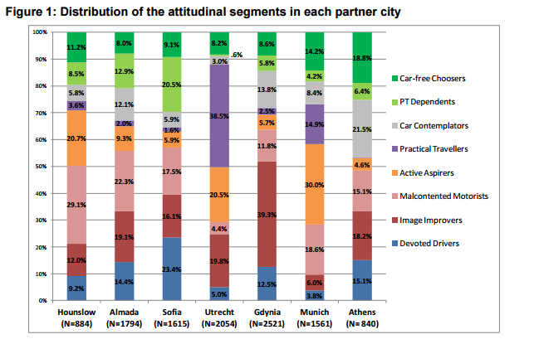
Complex segmentation statistical analysis
SEGMENT:

Slide 17
Example: the Hammersmith campaign
Hammersmith (UK), car park of a mall
Baseline questionnaire
21 different brochures: different modes, rational vs. emotional, contemplator vs. pre-contemplator
Test of segmentation technique
Control group: no intervention
Standard group: uniform intervention, all modes
MaxSem segmented group: only relevant mode
Pre-contemplator, rational
Pre-contemplator, emotional
Contemplator, rational
Contemplator, emotional

Slide 18
Example: the Hammersmith campaign
Hammersmith (UK), car park of a mall
Baseline questionnaire
Incentive: payment of parking charge (not coffee)
21 different brochures: different modes, rational vs. emotional, contemplator vs. pre-contemplator

Slide 19
NON THEORY
CIVITAS Training Workshop, Toulouse, 17th-18th May, 2011
m.carreno@napier.ac.uk
Notes:
Targeting attitudes towards car sharing
Same info but no supporting messages or photos
From TfL website
19

Slide 20
CONTEMPLATIVE: car-sharing-emotional booklet
CIVITAS Training Workshop, Toulouse, 17th-18th May, 2011
m.carreno@napier.ac.uk
Notes:
Targeting attitudes towards car sharing
Emotional based- feel good, less stressful, greener
20

Slide 21
CONTEMPLATIVE: Car-sharing-rational booklet
CIVITAS Training Workshop, Toulouse, 17th-18th May, 2011
m.carreno@napier.ac.uk
Notes:
Targeting attitudes towards car sharing
Rational based- cheaper, quicker
21

Slide 22
Hammersmith results
Reduction of car trips into Hammersmith:
9 people (18%) in MaxSem emotional group
6 people (15%) in MaxSem rational group
3 people (9%) in standard group
1 (4%) person in control group
In all groups increases in car use !
Moving stage of behaviour change (mainly contemplators):
31% of MaxSem emotional group
28% MaxSem rational group
21% of standard (non-theory) group
11% of control group

Slide 23
Hammersmith results
Did the brochures made them think about their own behaviour?
Overall, 70%
78% Emotional
68% Rational
28% Non-theory
Stage movement and making people think about their behaviour:
If not measured you will underestimate the impact
Further intervention needed to achieve actual change?
Notes:
Total cost of campaign
About 17,000 euro
Lot of personnel time

Slide 24
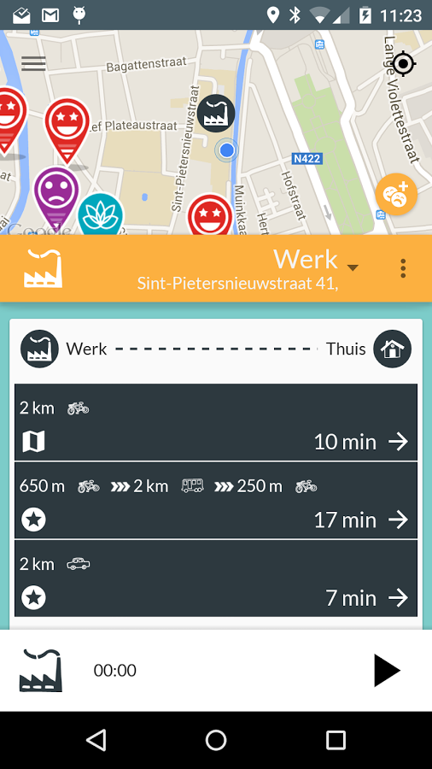
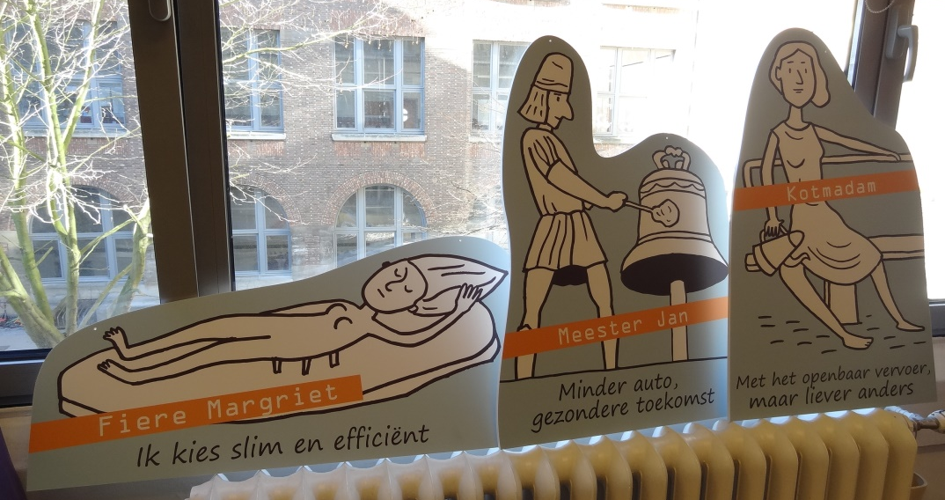
Segmentation in Routecoach
Trip tracking app from NISTO project
Leuven, Belgium
Baseline questionnaire → 7 profiles
Tailor-made advice on alternative routes and modes

Slide 25
Segmentation and social marketing
Questions ?
Ask questions by:
Raising your hand via the GoToWebinar Control Panel
Starting a chat in your control panel

Slide 26
The SEGMENT project
The SEGMENT campaign in Utrecht
Mark Degenkamp Senior Advisor Mobility Policies City of Utrecht

